Slide 1
Superstore Business Performance Analysis (2014-2017)
Presenter's Name: Omar Hamdy
Date: 17/5/2025
17/5/2025

Slide 2
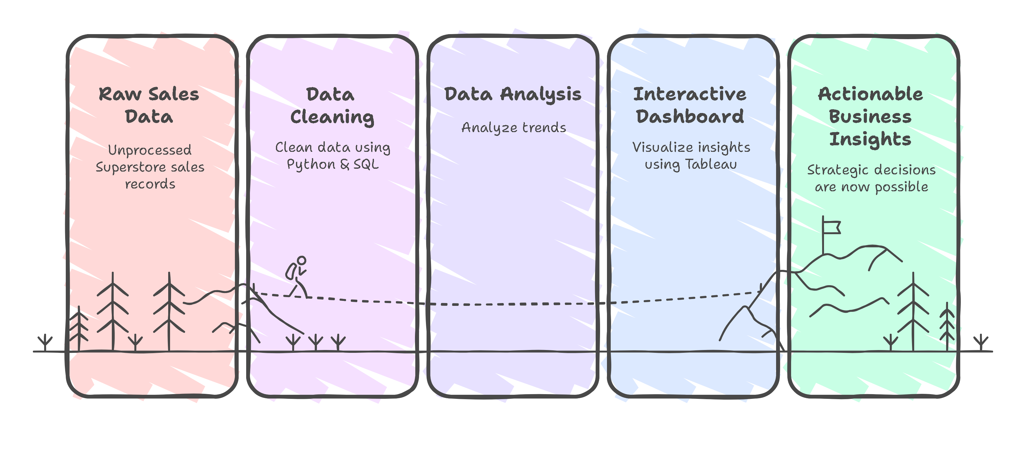
Project Idea
- Problem: Superstores generate large volumes of sales data over time, but decision-makers often struggle to extract actionable insights related to profit, order trends, product performance, and regional demand. Without proper analysis, opportunities for growth, efficiency, and customer targeting are missed.
- Proposed Solution: I conducted a comprehensive performance analysis of Superstore data (2014–2017), focusing not only on sales but also on profit trends, quantities sold, order volumes, customer behavior, product categories, regions, and shipping methods. Using data cleaning, modeling, and visualization, I created dashboards that deliver clear, data-driven insights.
- Unique Value Proposition: Unlike basic sales reports, this project offers a multi-dimensional analysis that uncovers deep patterns across time, geography, and product types. It combines strong data preprocessing (Python, SQL) with professional-level visualization (Tableau, Figma), providing business leaders with actionable recommendations to boost profitability and operational performance.
17/5/2025

Slide 3
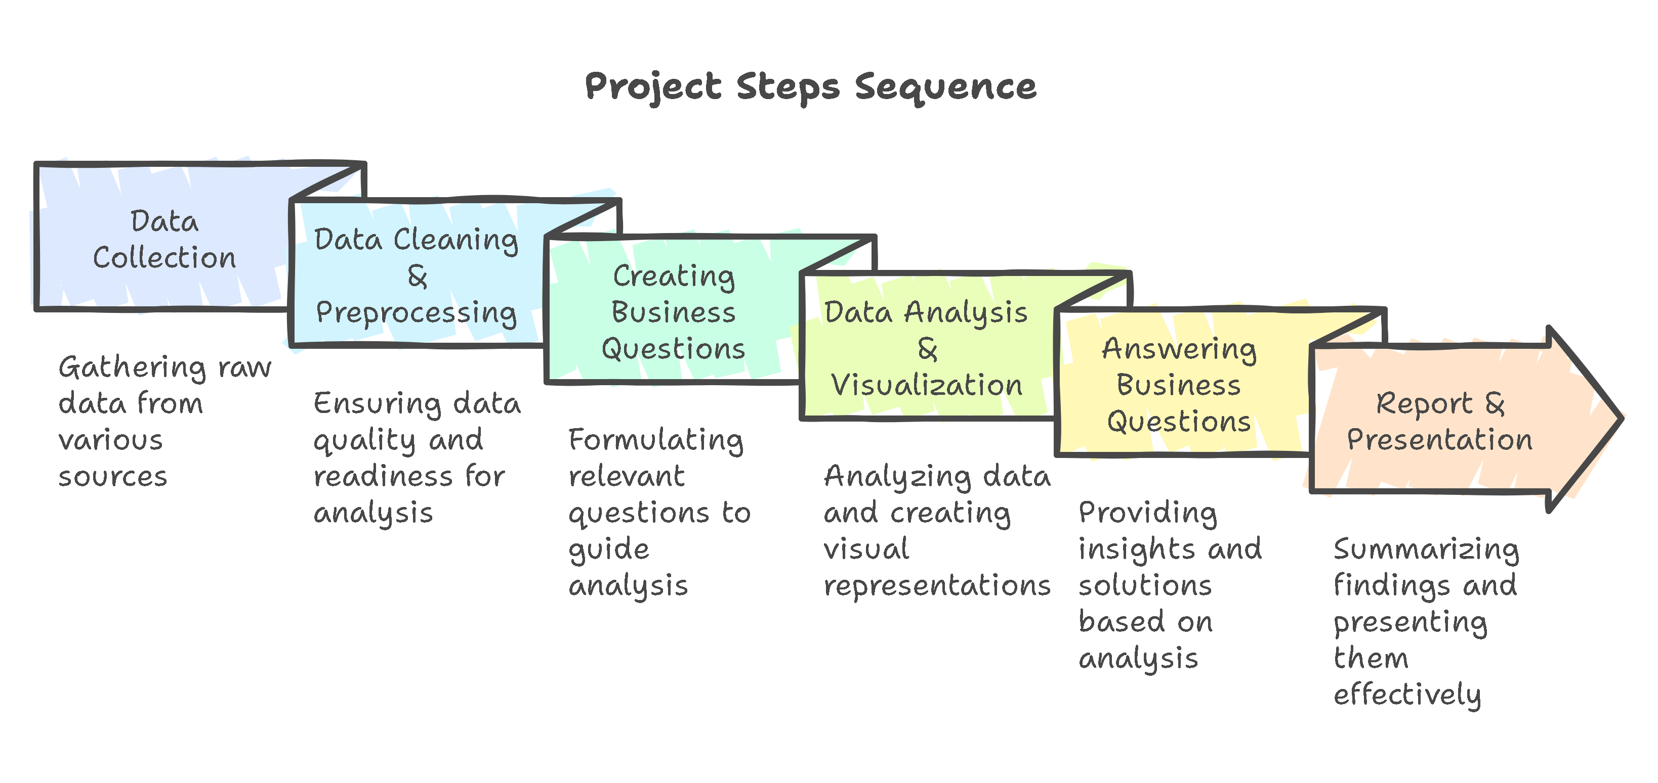
17/5/2025

Slide 4
Visual Layout
We developed a clean, intuitive dashboard using Draw.io for initial wireframes and Figma for UI design. The layout strategically emphasizes key KPIs to support data-driven decisions:
Primary KPIs: Total Sales, Profit, Orders, and Customers
Interactive Filters: Year, Region, Category, and Segment
Visual Components: Bar charts, line charts, geo maps, and KPI summary cards for quick insights

Slide 5
User Journey:
The dashboard was designed with a seamless, user-friendly flow to support efficient analysis:
Entry Point: User lands on the dashboard homepage.
Interaction: Applies filters (e.g., Region = West, Year = 2016) to tailor insights.
Exploration: Reviews charts segmented by Category and Sub-Category.
Insight Discovery: Identifies patterns such as underperforming products, top segments, or logistic inefficiencies.
Action: Makes informed decisions—e.g., optimizing shipping processes or targeting profitable regions.

Slide 6
Focus on Usability:
To ensure a positive and productive user experience, we prioritized:
Clarity: Clean layout with minimal distractions
Visual Communication: Color-coded elements for faster interpretation
Interactivity: Simple and accessible dropdown filters
Responsiveness: Design adapts across devices for consistent accessibility

Slide 7
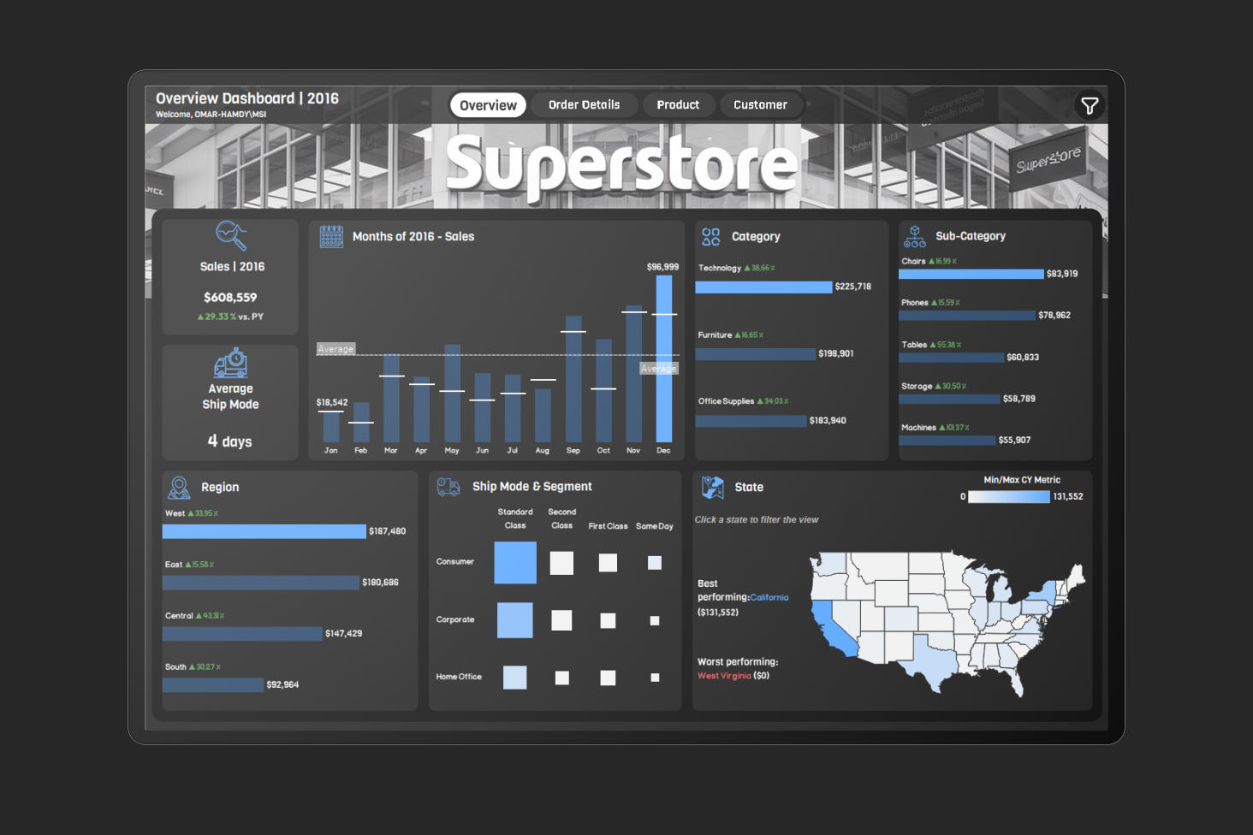
Overview Dashboard
Purpose: This dashboard provides a high-level summary of a business’s overall performance, covering sales trends, product categories, regional activity, and operational metrics like shipping.
Key Features: It typically includes visuals for monthly sales patterns, breakdowns of product categories and subcategories, regional or geographic performance, shipping options, and a map highlighting location-based activity.
17/5/2025

Slide 8
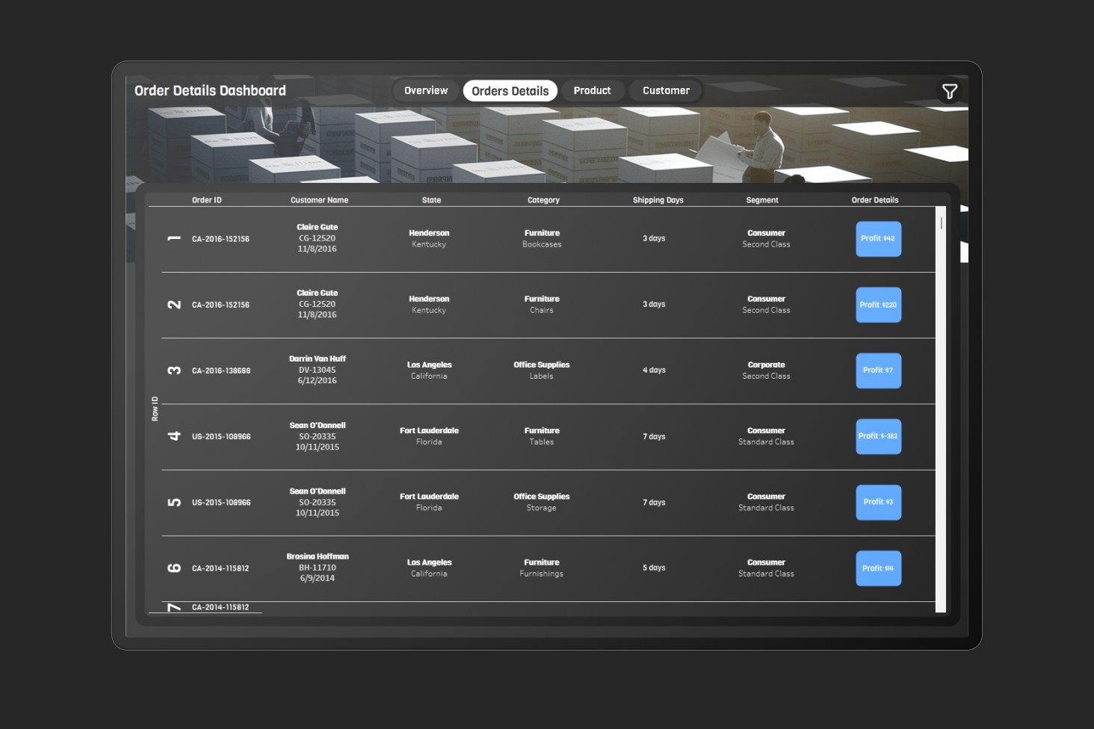
Order Details Dashboard
Purpose: This dashboard tracks individual transactions, offering a detailed look at each sale to understand customer behavior and operational efficiency.
Key Features: It typically lists orders with columns for identifiers, customer names, store locations, product types, shipping timelines, customer segments, and profitability indicators.
17/5/2025

Slide 9
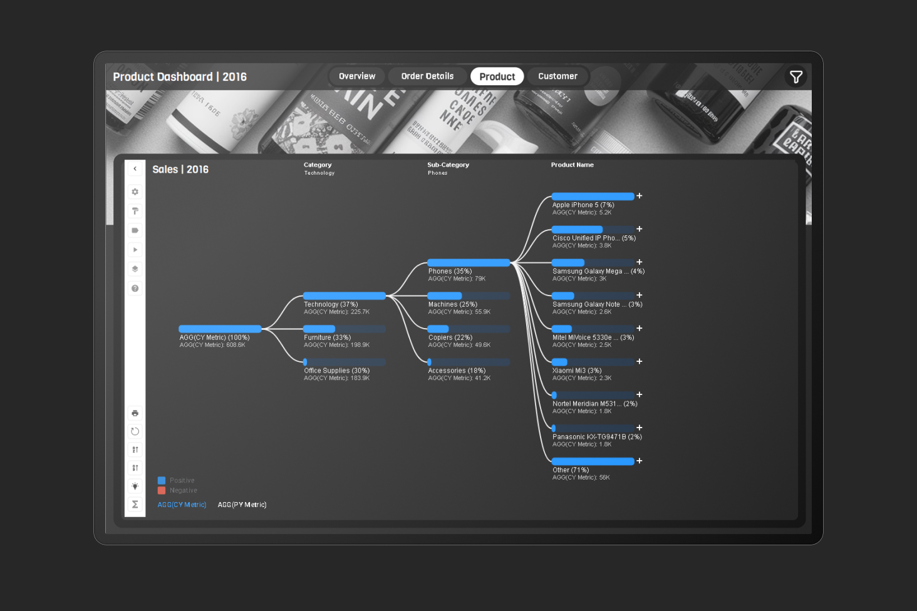
Product Dashboard
Purpose: A product-focused dashboard analyzes sales performance across categories and subcategories, often comparing current trends to past performance.
Key Features: It often uses flow diagrams to break down sales into broad categories (e.g., technology, furniture, office supplies) and narrower subcategories (e.g., phones, chairs, storage), while also showing growth trends.
17/5/2025

Slide 10
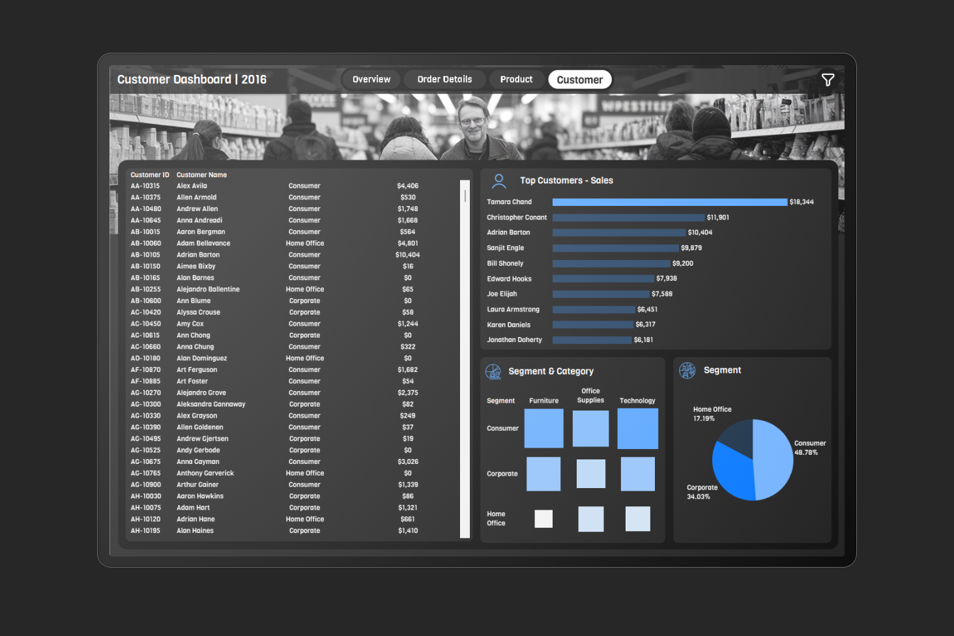
Customer Dashboard
Purpose: This dashboard focuses on the customer base, analyzing purchasing behavior and segmenting buyers to uncover key trends.
Key Features: It typically includes a list of customers with their segments (e.g., individual consumers, corporate clients, home office buyers), a ranking of top spenders, and visual breakdowns of segments and product categories purchased.
17/5/2025

Slide 11
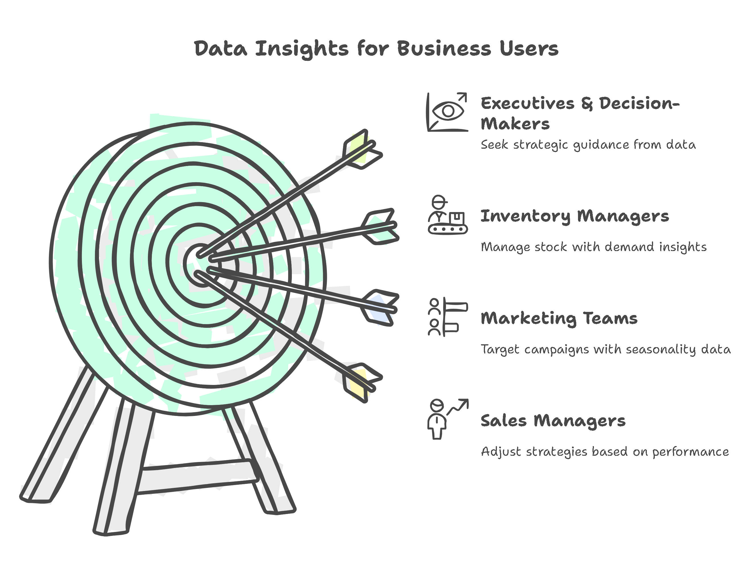
End Users
Sales Managers: Need to track revenue, profit trends, and top-performing products to adjust strategies.
Marketing Teams: Use insights about seasonality and regional demand to run targeted campaigns.
Inventory Managers: Require visibility into high-demand items and underperforming products to manage stock levels.
Executives & Decision-Makers: Seek clear visual summaries to guide strategic decisions.
17/5/2025

Slide 12
Key Features & Benefits:
Feature | User Need Addressed
Interactive Tableau Dashboards | Quick and clear decision-making through visual storytelling
Profit & Order Trend Analysis | Helps Sales Managers understand performance over time
Category & Sub-Category Breakdown | Assists Marketing in product targeting and campaign focus
Regional & State-Level Insights | Guides expansion or optimization efforts by Executives
Shipping Method Analysis | Helps Operations improve logistics and customer satisfaction
Customer Segmentation Analysis | Supports Marketing with tailored messaging for each segment
17/5/2025

Slide 13
Data Structure
Data Source: Superstore Dataset (CSV, 9,994 rows)
Structure: Relational, used star schema with Fact & Dimension tables
Key Features: Sales, Profit, Quantity, Discount, Date, Region, Product Info
Techniques: Data cleaning (Python), EDA, Data Modeling, Visualization
17/5/2025

Slide 14
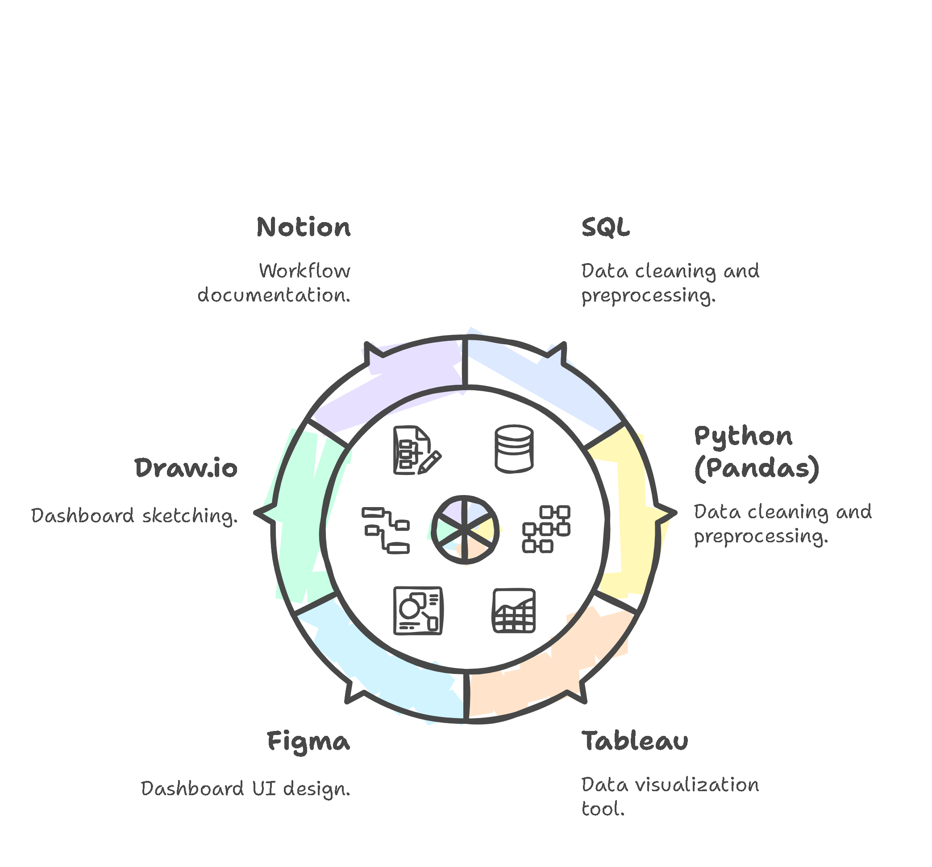
Tools Used
SQL – data cleaning & preprocessing
Python (Pandas) – data cleaning & preprocessing
Tableau – data visualization
Figma – dashboard UI design
Draw.io – dashboard sketching
Notion – workflow documentation
17/5/2025

Slide 15
Live Application + Test
📌 Current Status: The project has been fully completed and presented. All dashboards and analysis outputs are functional and were tested before submission.
🧪 Testing Process:
Conducted thorough data cleaning using SQL and Python to ensure consistency and accuracy.
Validated key metrics (sales, profit, quantity, customer count) across different dimensions (time, region, category).
Compared results with manual Excel summaries to ensure correctness.
Reviewed Tableau dashboards to ensure filters, visual logic, and KPIs are working properly.
17/5/2025

Slide 16
Deliverables
Here are the final deliverables provided at the end of the project:
📊 Tableau Dashboard File – Contains the interactive visualizations.
🐍 Jupyter Notebook – Used for data cleaning and preprocessing with Python (Pandas).
🛢️ SQL Script File – Includes queries for data cleaning and transformation.
🧩 Draw.io File – Used to sketch the dashboard layout and data schema.
🎨 Figma Designs (Images) – Dashboard UI design mockups.
❓ Business Questions (PDF) – Document listing the business questions addressed in the analysis.
📝 Final Report (PDF) – Detailed summary of the entire project, including methodology and insights.
📽️ Presentation File – PowerPoint or PDF presentation summarizing the project.
17/5/2025

Slide 17
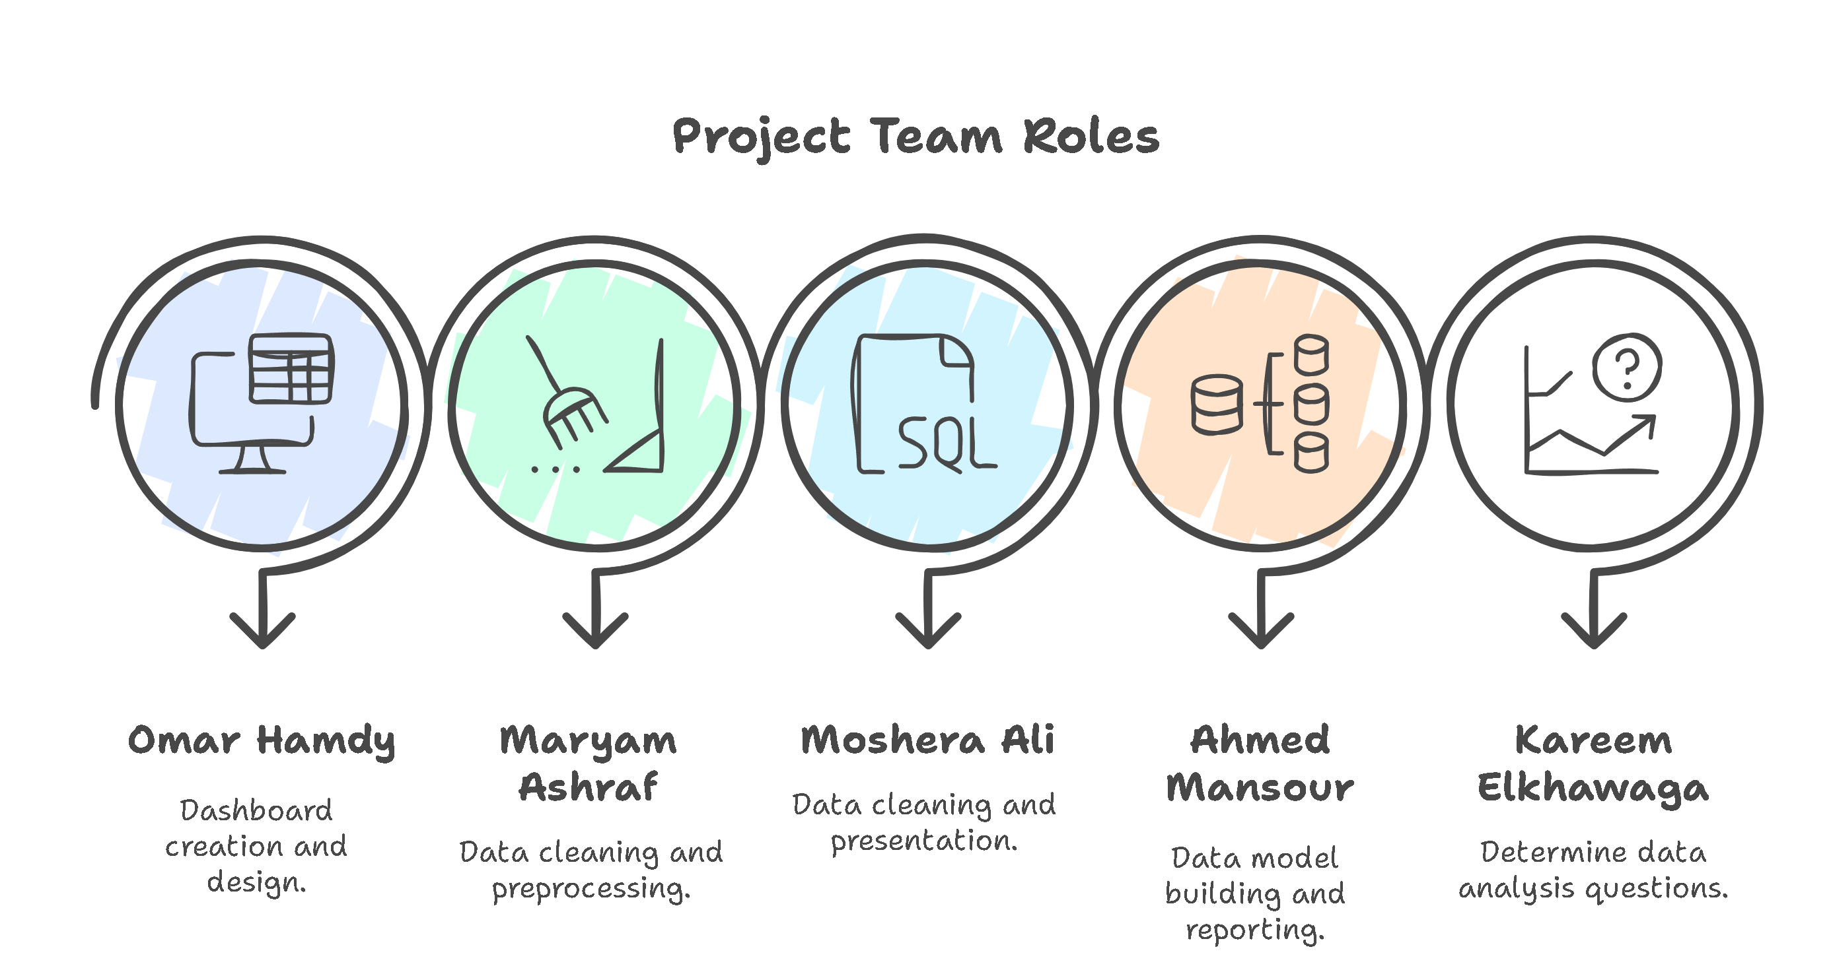
17/5/2025

Slide 18
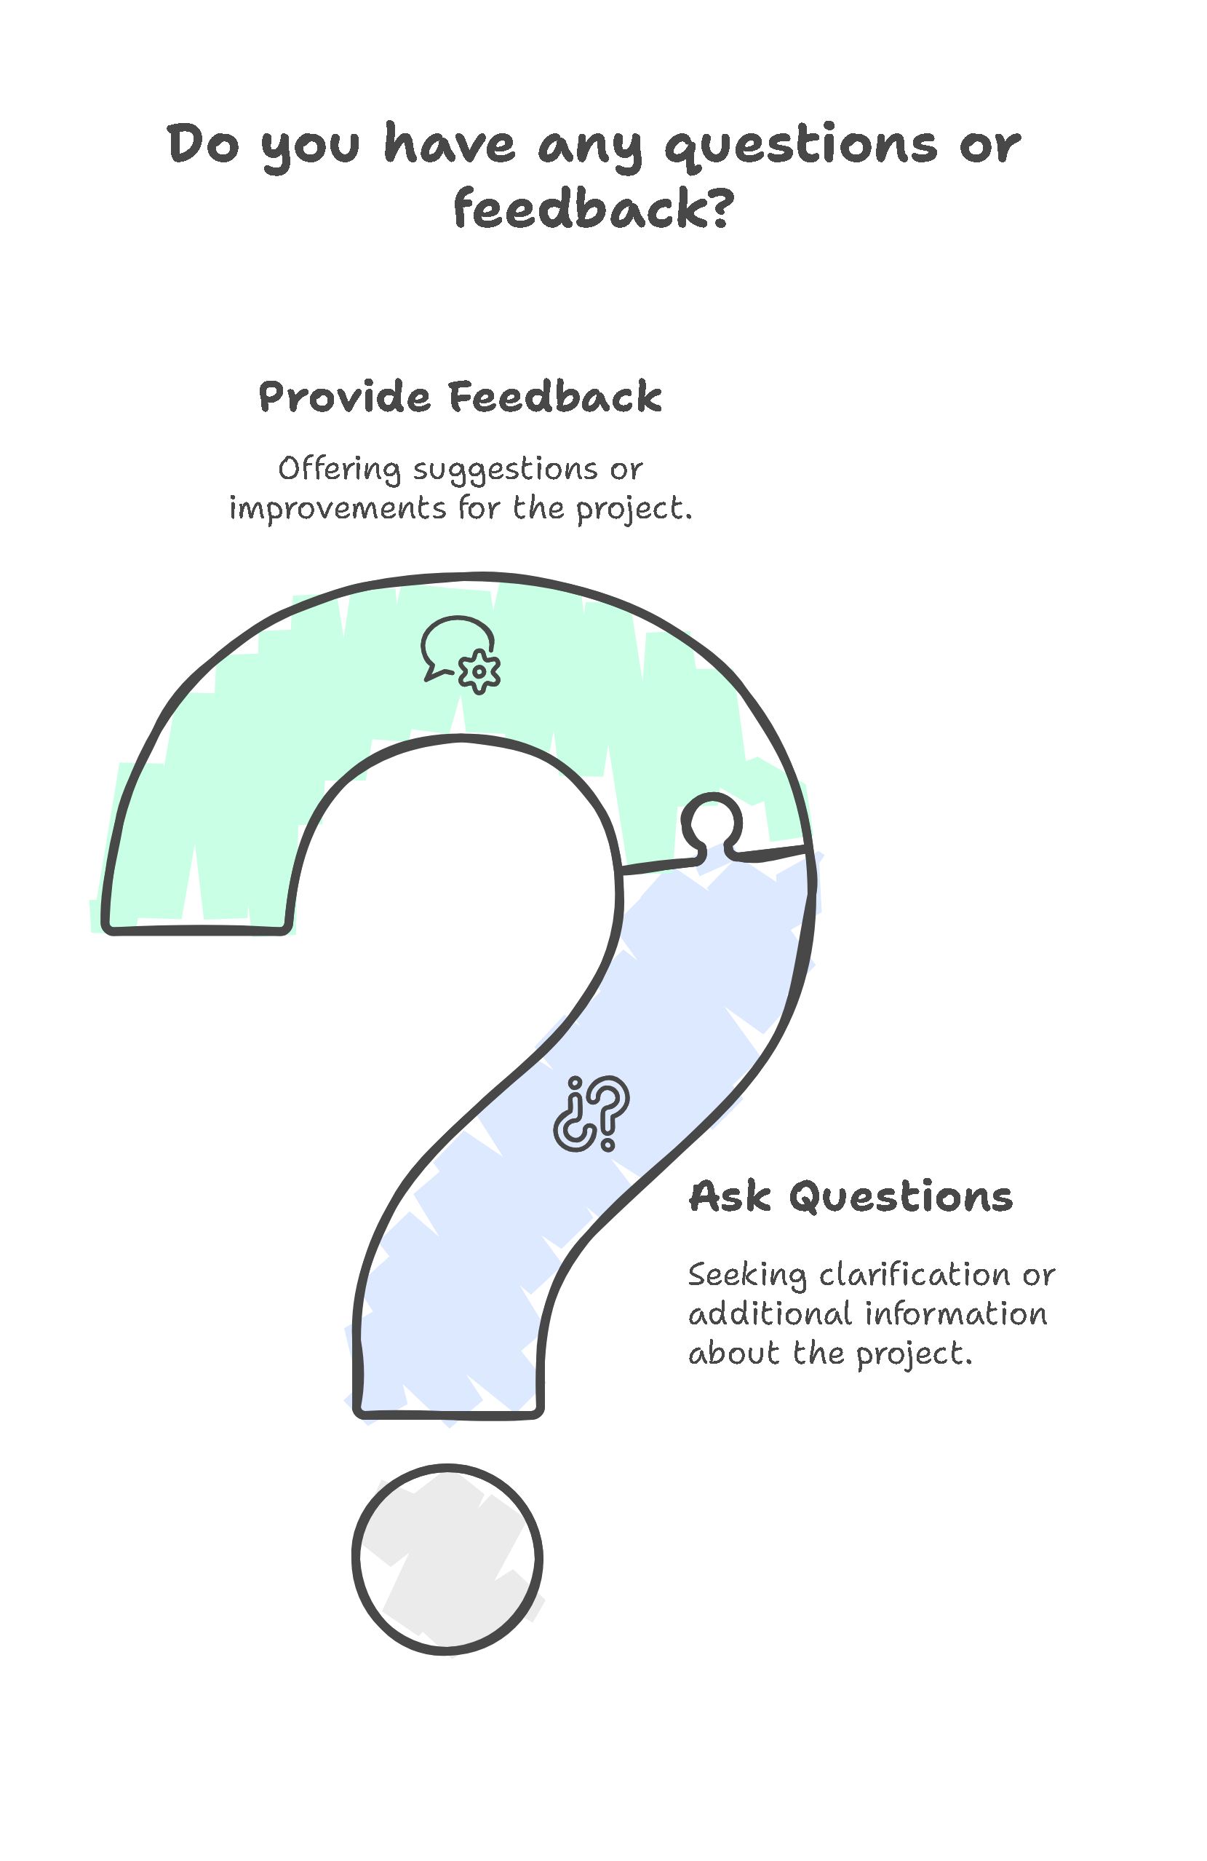

THANK YOU!
17/5/2025

